Slide 1
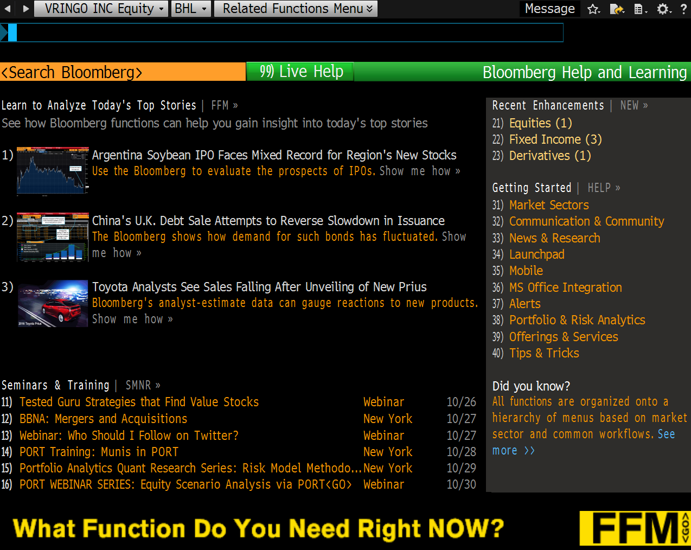

Slide 2
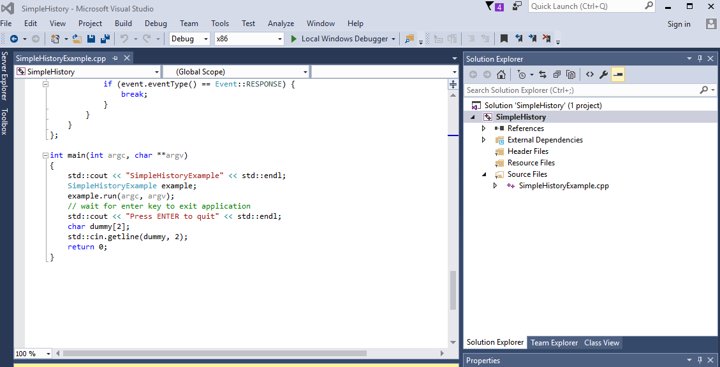
Create SimpleHistoryProject

Slide 3
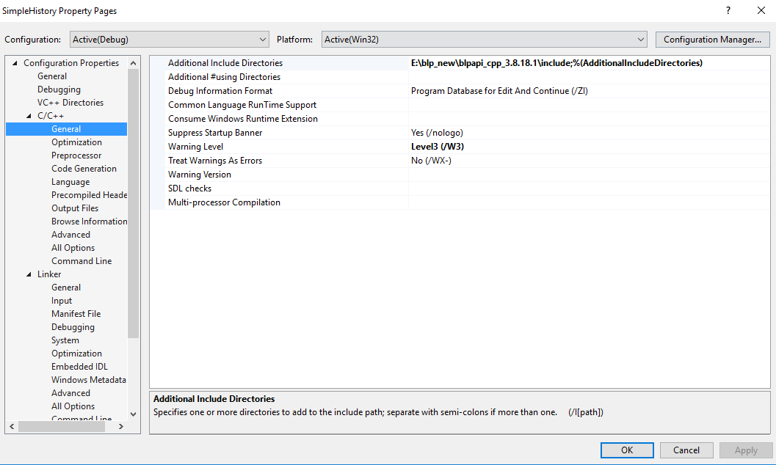
Add BLP include file directory

Slide 4
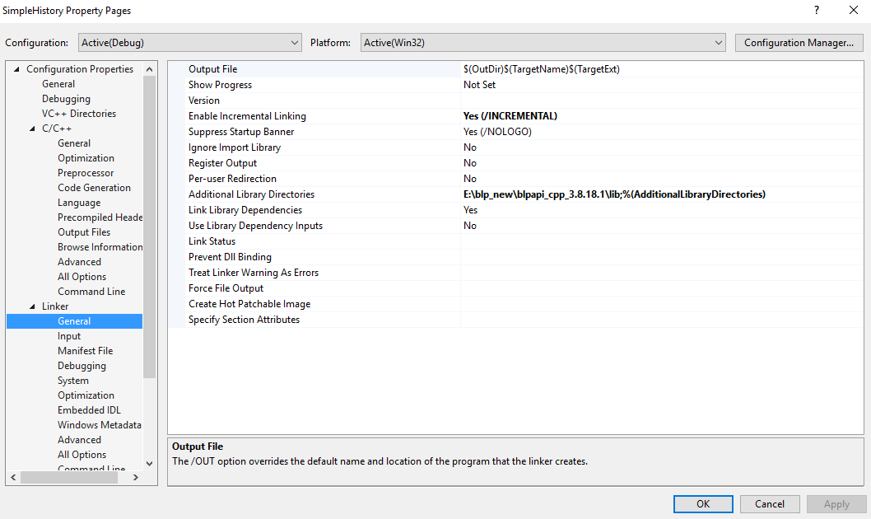
Add BLP library

Slide 5
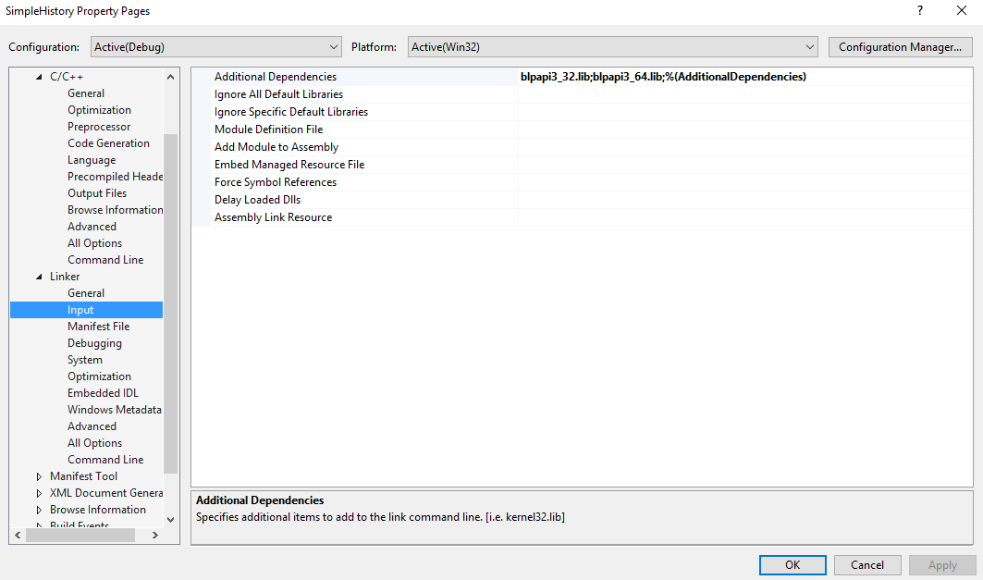
Specify BLP library for your program

Slide 6
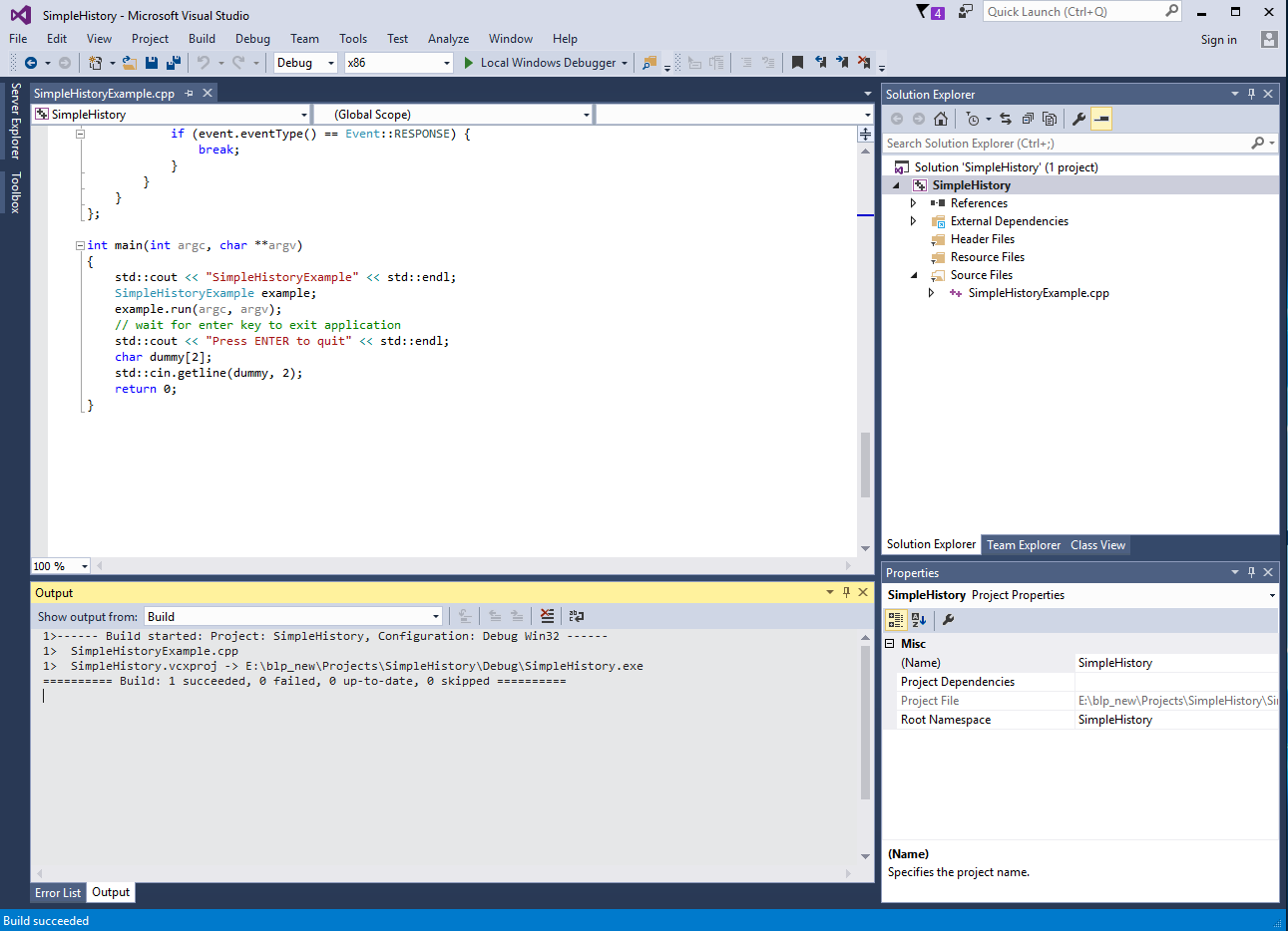
Build your program

Slide 7
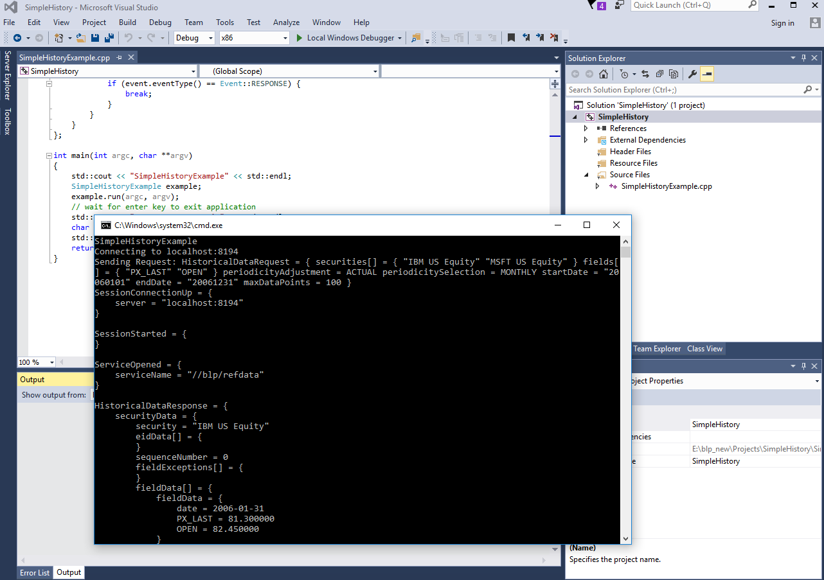
Run your program

Slide 8
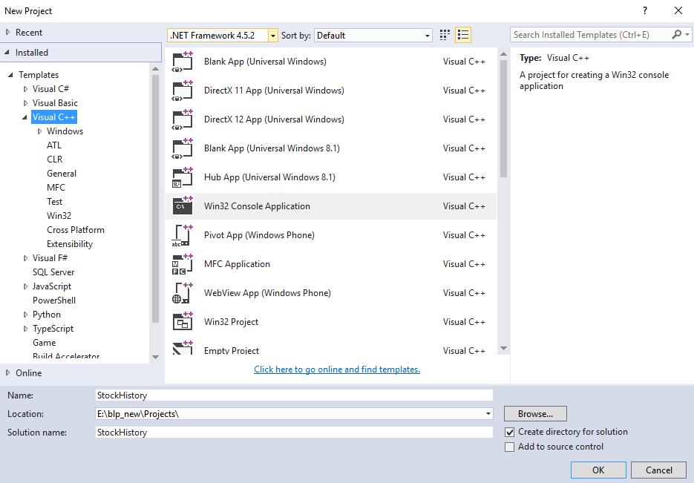
Homework - StockHistory

Slide 9
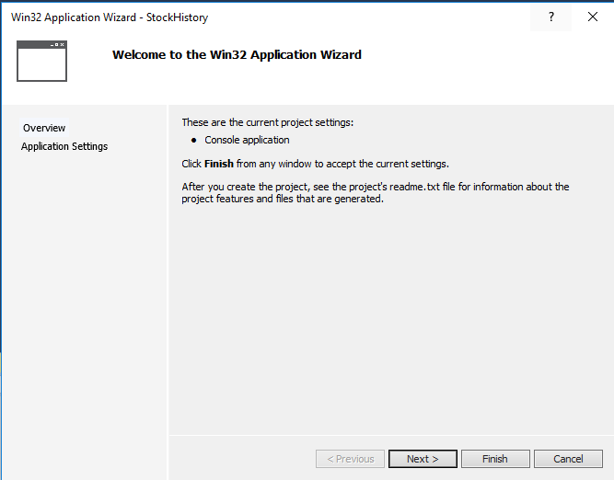

Slide 10
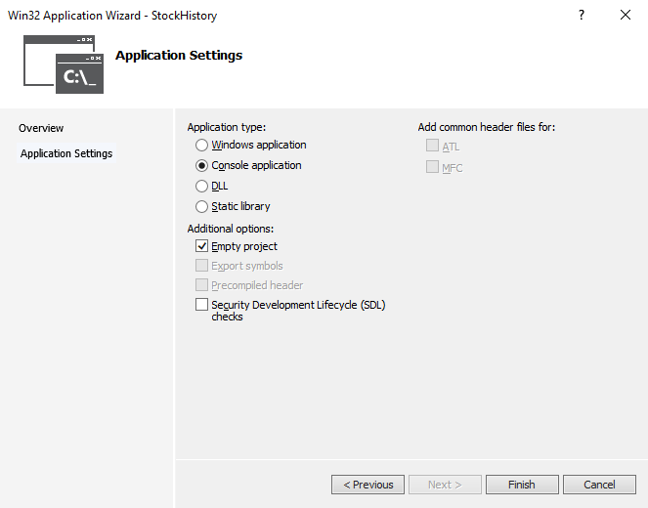

Slide 11
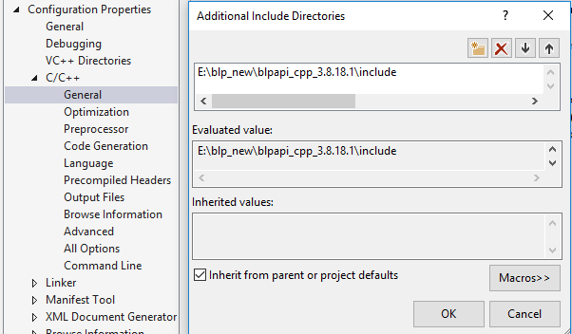

Slide 12
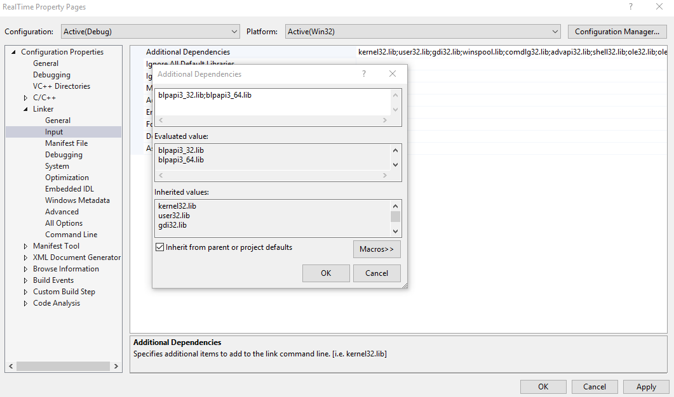

Slide 13
References
Market Data Explained: A Practical Guide to Global Capital Markets Information. (The Elsevier and Mondo Visione World Capital Markets), Mark Alvarez, Butterworth-Heinemann, 2006, ISBN-10: 0750680555
Bloomberg API, www.bloomberglabs.com/api/libraries
Bloomberg API, Version 3.x, Developer’s Guide, June 30, 2014 Version 2.54, bloomberglabs.com/content/uploads/sites/2/2014/07/blpapi-developers-guide-2.54.pdf.
Programming the Bloomberg Open API using C++ Real-Time Data with Subscriptions, holowczak.com/bloomberg-api-cpp-win32-subscriptions.

